Slide 1
Smart Attendance System
Pranjal Parmar (181290107040)
Parshu Acharya (181290116001)
Priyank Shah (181290116051)
Meet Somani (181290116054)

Slide 2
Outline
What is Smart Attendance System?
How does it work?
How can it impact the society
Advantages
Technicals Used
Screenshots

Slide 3
Abstract - Smart Attendance System
The basic problem that we face in our day to day lives is the attendance that is to be taken in schools & colleges. Almost 5-10 minutes are wasted in every lecture for this minute task that is attendance.
Nowadays, almost every classroom is equipped with the CCTV camera. So, Basically we carved out a way with resources already available. We integrated the face recognition and detection system in camera which automatically detects the faces and automatically marks the attendance of the student.
Here, this is totally focused on the system and there is no human intervention.

Slide 4
Abstract - Smart Attendance System
This is a smart attendance system which solely works automatically without human intervention. The attendance of the person is marked directly into the sheet.
Smart Attendance System works through a webcam in which it recognizes the face and marks the attendance directly into the sheet which makes our attendance system more robust and efficient.
This not only can used for attendance system but also for the security purposes too.

Slide 5
How does it work?
We first need to feed in the system the photos of the person to which we need to mark attendance of.
Once the machine learns its face and everything we just need to run the “.exe” file and mention the time we need to mark the attendance.
For suppose we get our classes started at 10:30 the we can run from 10:00 to 10:45.
In this time period only the system will run and mark the attendance of the one that comes in front of webcam directly into the .csv file

Slide 6
How can it impact the society?
In our traditional attendance system there is waste of time in the class while taking attendance.
There are also some chances of proxy attendance too.
So in order to avoid all these issues and making the attendance system more efficient we can use this smart attendance system.
This not only can be used for attendance but for security purposes too.

Slide 7
Advantages
More efficient than traditional system
More robust
No chances of proxies
Accurate date and time
No human intervention
Less work for teachers and authorities

Slide 8
Technical Details
This smart attendance system is made with the help of Python language.
We have used Libraries such as:
OpenCV
Face_Recognition
Numpy
Tkinter
Datetime
cv2

Slide 9
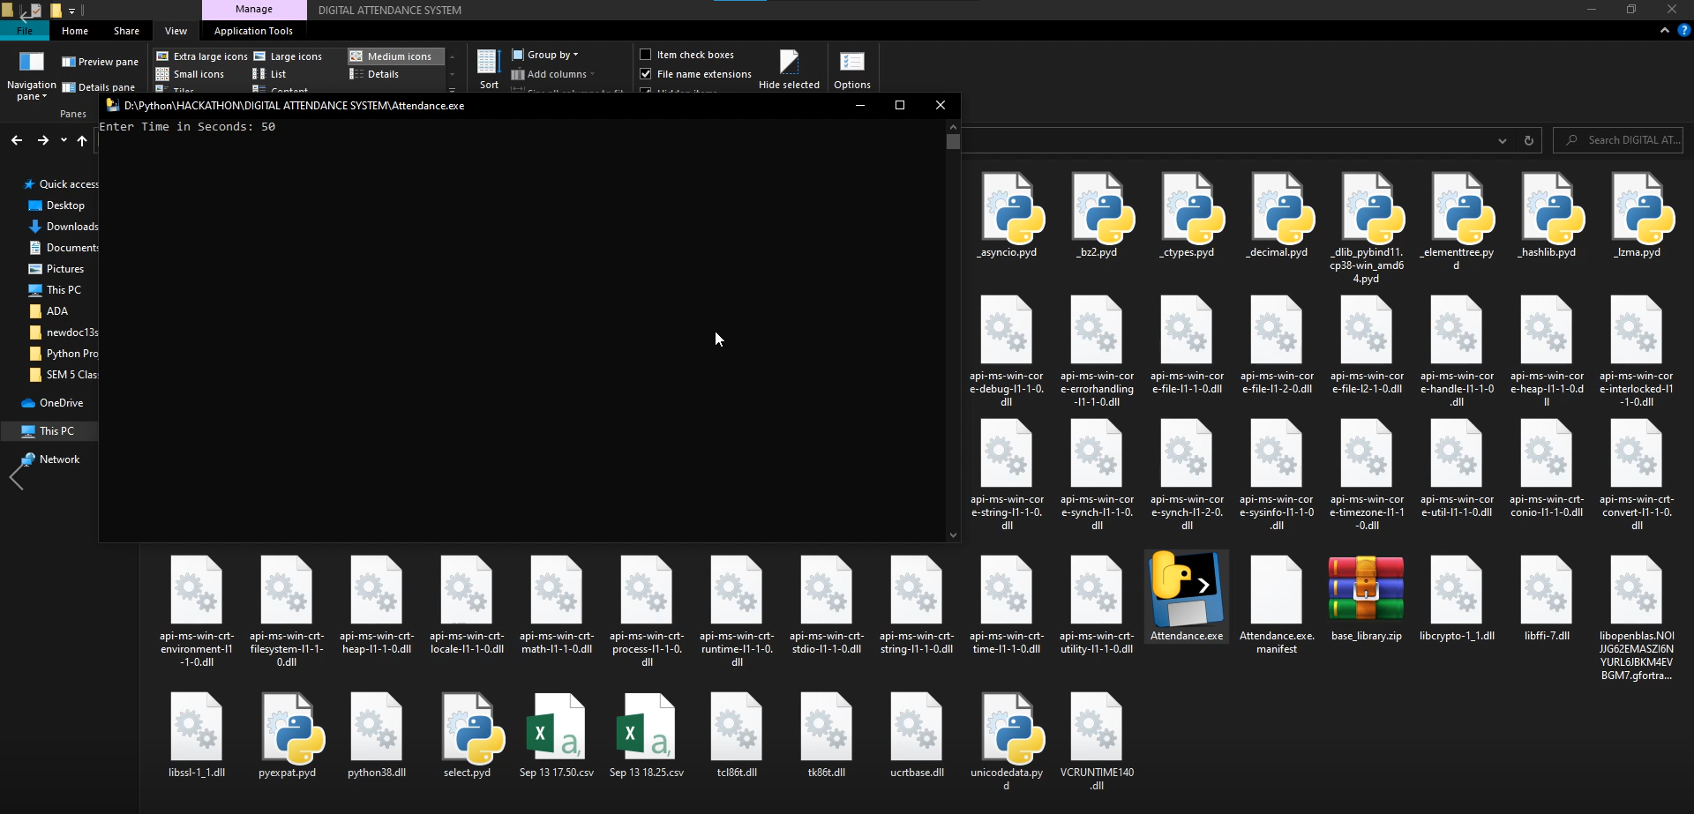

Slide 10
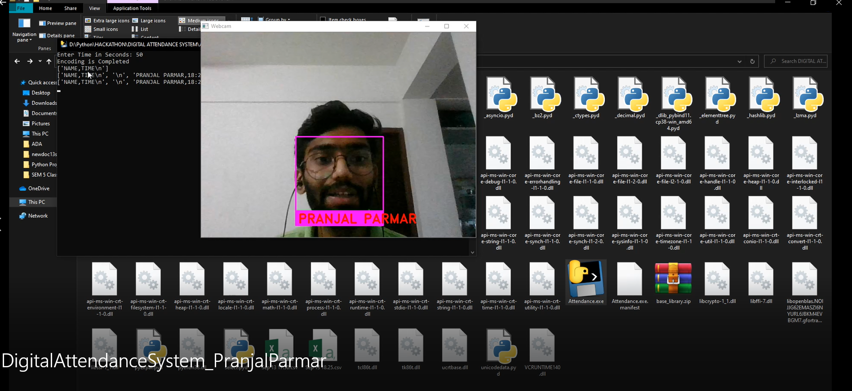

Slide 11
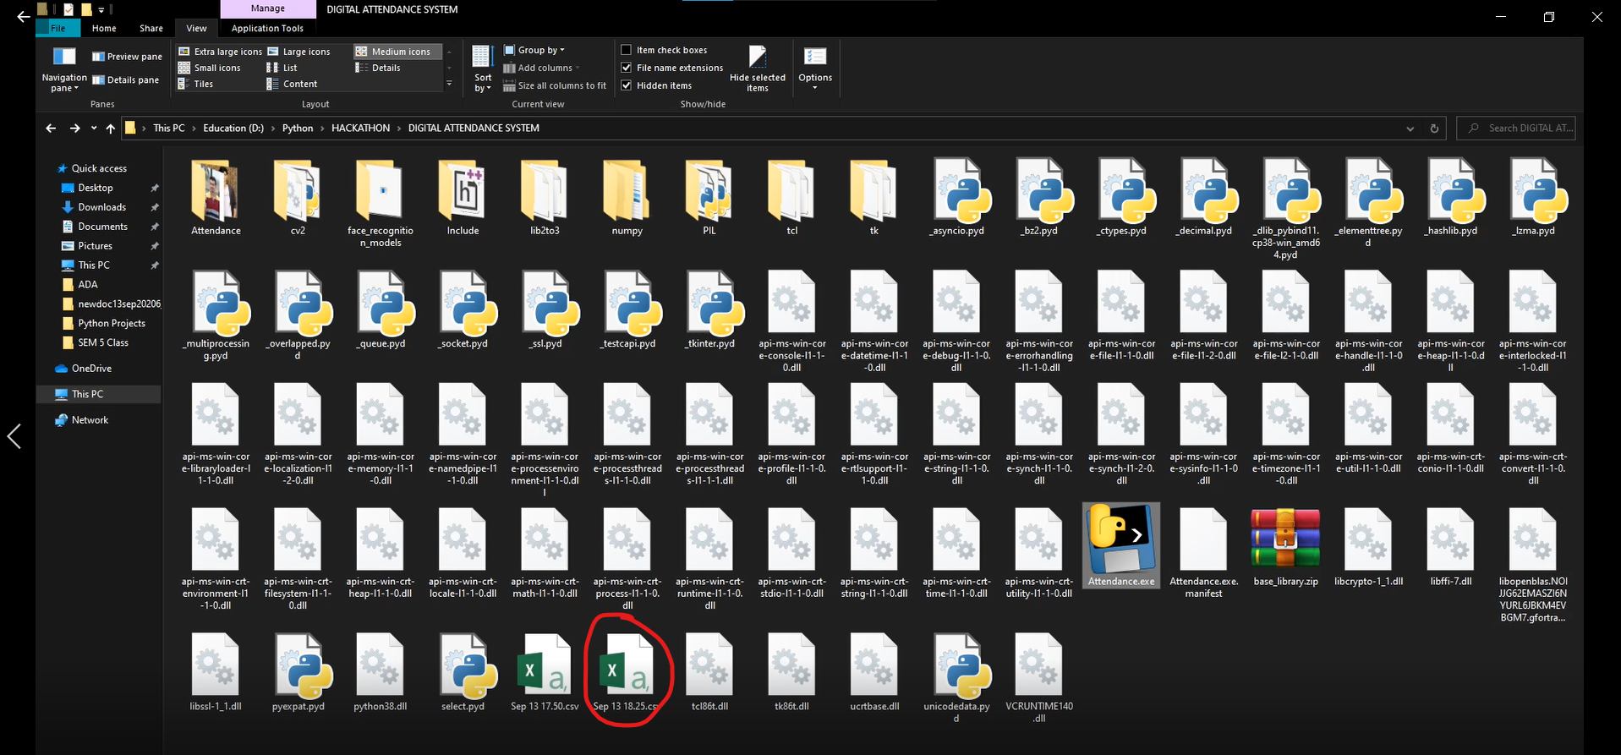

Slide 12
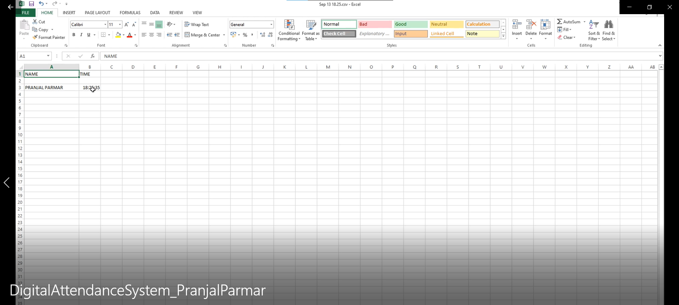

Slide 13
Thank You!

